Slide 1
FLIGHT SAFETY
BY KARINA VAN TWISK

Slide 2
INCIDENT SUMMARY 2023
TRENDS (2020 to 2023)
SAFETY INITIATIVES
SAFETY RECOMMENDATIONS
TRAINING & AWARENESS

Slide 3
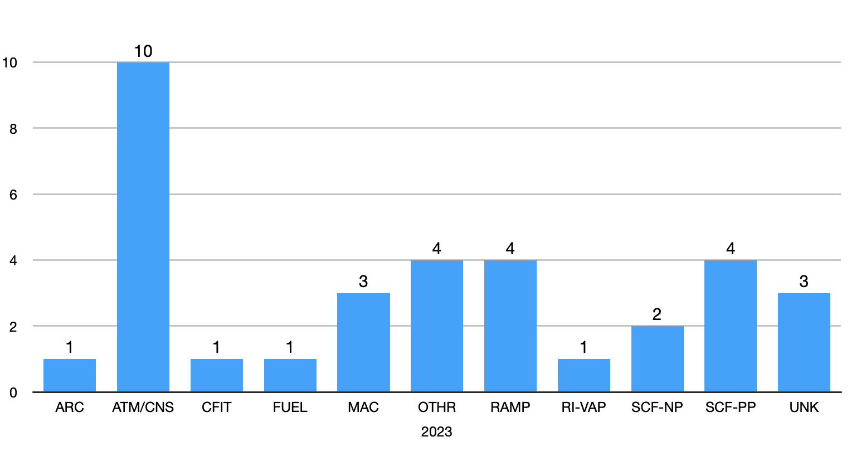
Incident Summary
2023

Slide 4
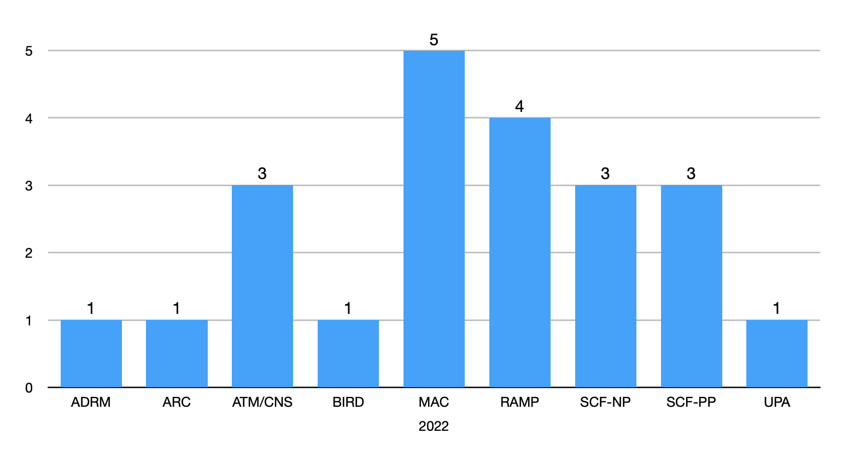
Incident Summary
2022

Slide 5
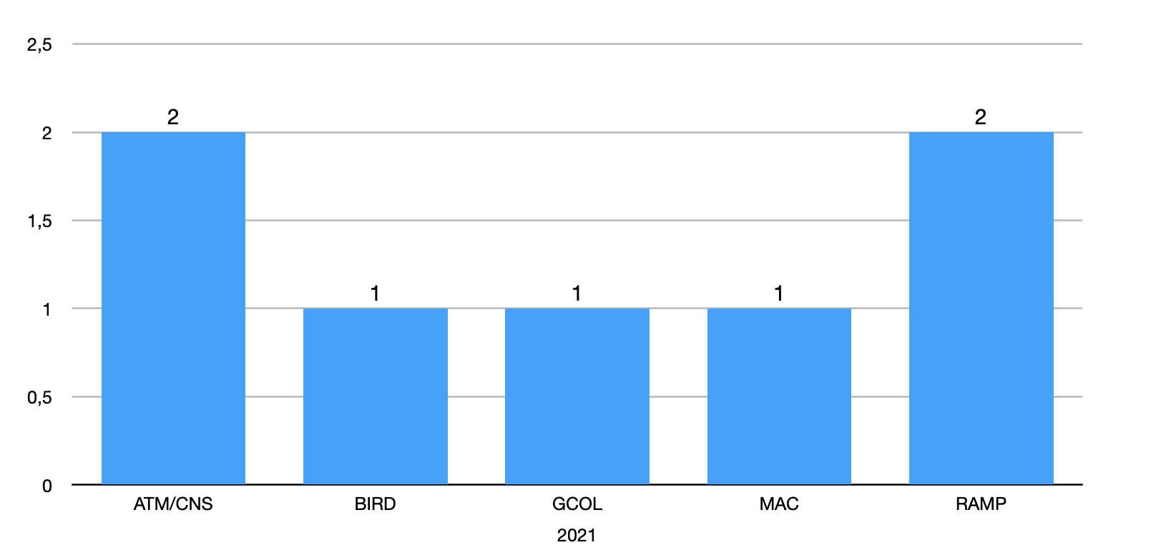
Incident Summary
2021

Slide 6
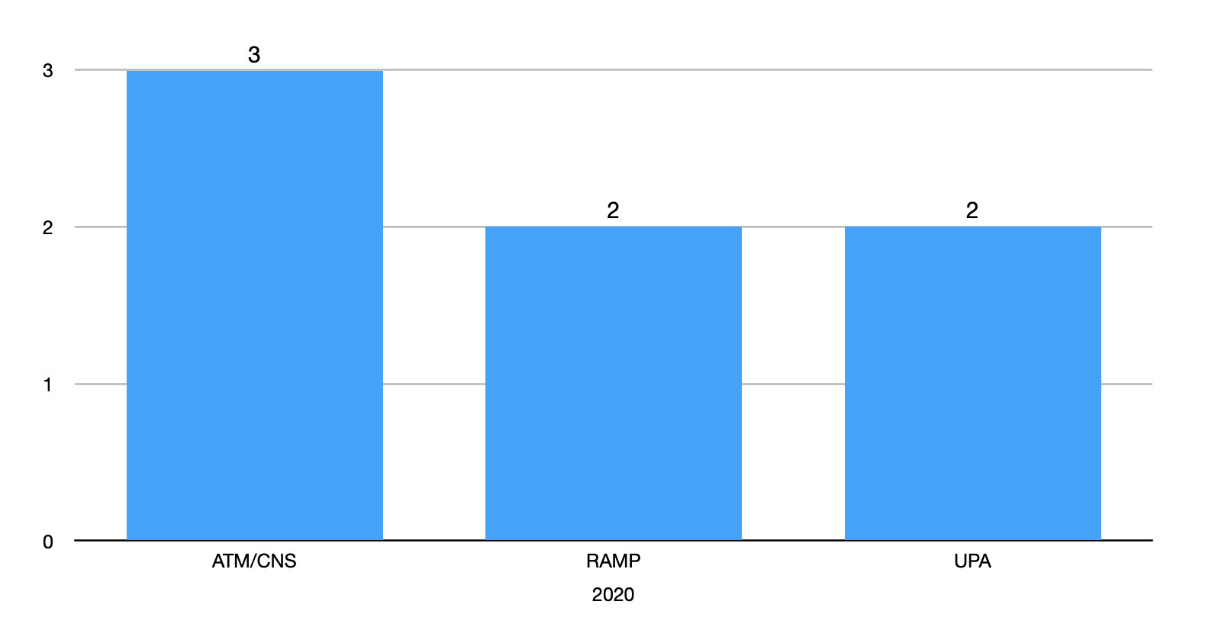
Incident Summary
2020

Slide 7
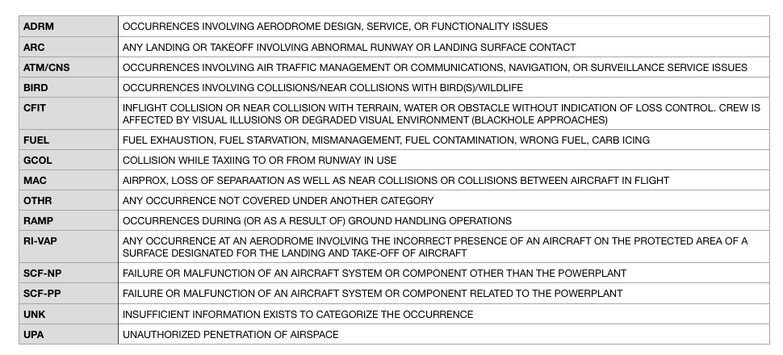
Categories

Slide 8
Trends

Slide 9
Safety Initiatives
Report it! (email, paper form, digital invoice system)
Reports lead to positive changes
Posters, Safety Briefs, Leaflets
Share your experiences with other pilots and s-pilots
Proactive with pilots and home airport’s manager

Slide 10
Safety Recommendations
Do your homework, prepare your RT according to your mission
Mark TMA/CTR boundaries and frequency changes
Change frequency when approved by the current one
Monitor and create situational awareness
Read back Clearance or Flight Information (QNH)
Comply; set QNH, set Transponder as req.

Slide 11
Safety Recommendations
Request “Radio Check” if comm is poor
Request CONFIRMATION from ATC if not sure or in doubt
Keep Looking Out!
Maintain Situational Awareness at all times
AVIATE, NAVIGATE AND COMMUNICATE in that order!

Slide 12
Safety Recommendations
Have someone to look out while manoeuvring aircraft in or out of the hangar
Create a routine-procedure for tanking, don’t get distracted by conversation
Close and lock baggage hatch, double check before stepping in the cockpit
Close and secure engine oil tank and access panel before moving on to your next checks

Slide 13
Safety Recommendations
Flying to uncontrolled airfields? request AD information and if there is any known traffic in circuit before joining
Have a good look out before turning from base to final
Keep a sharp eye for conflict traffic even in controlled airspace and of course outside OPR HRS at EHKD
Student Pilot flying SOLO? include STUDENT-PILOT in your transmissions

Slide 14
Safety Recommendations
Pre-flight check your aircraft according to checklist
If any concern arise or doesn’t meet your satisfaction? Consult with Fleet Management
Hazard observed?….report it!
In flight have your emergency checklist by your side

Slide 15
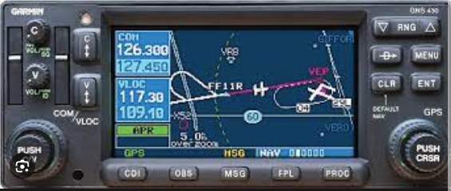
Safety Recommendations
Make use of GNS430 aboard the Aquilas to time your Fuel Tank Switch to Fullest Tank during cruise-flight

Slide 16
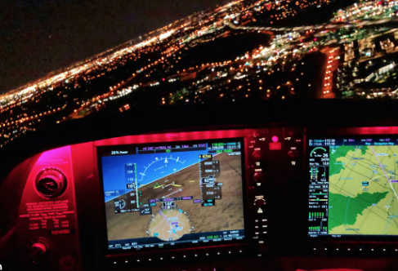
Safety Recommendations
During N-VFR operations, a black hole approach can give the illusion of flying too high. Transition “look-out” between in and outside
Flying N-VFR proficiency fades relatively quickly; stay proficient!

Slide 17
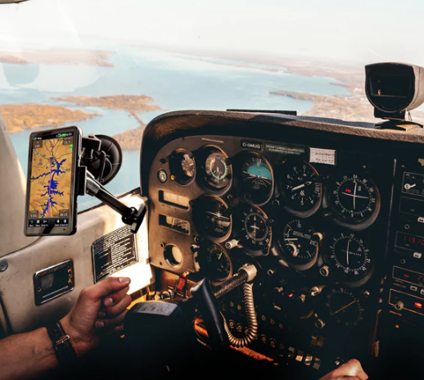
Safety Recommendations
During pre-flight checks, make sure all items on your checklist are checked (that includes aircraft’s papers) be proactive
Flying with a mini Ipad? make sure to install it on a place where outside visibility is not compromised
And make sure the mini Ipad does not block your view of controls and switches

Slide 18
Training and Awareness
AOPA Netherlands workshops: duration 3 hours including pause
Increase Safety Awareness in General Aviation
Interested? Let us know

Slide 19
“ASK WHY, NOT WHO!”
– Just Culture

